Slide 1



Replication & Sharding

Slide 2

Objectives
What is cluster
Types of Cluster in MongoDB
What is Replication, Why Replication
Setting up Replicated Cluster Replicate the DB
Write and Read operation on ReplicaSet

Slide 3

Introduction to Clusters

Slide 4
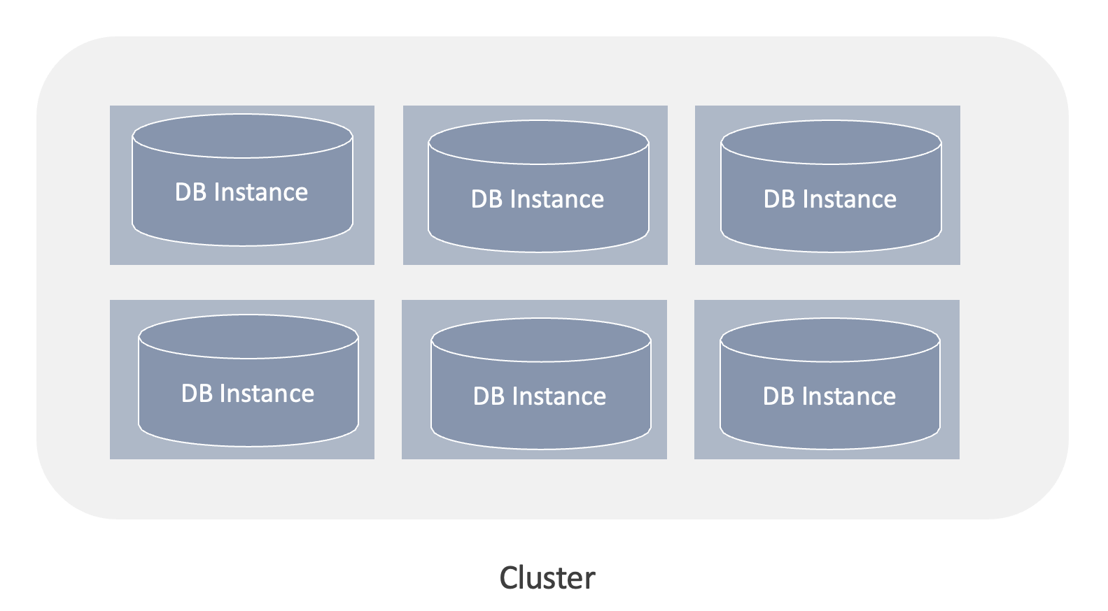
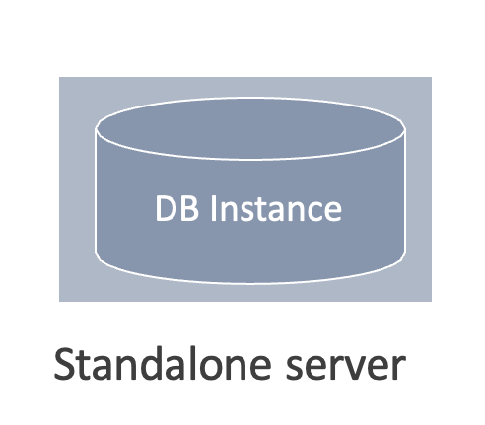
What is a cluster?
A group of identical resources is called a cluster.
A cluster can consist of a set of machines, servers, or instances.

Slide 5
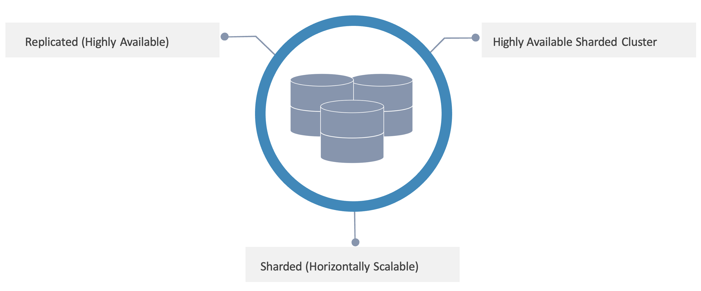
Types Of Clusters In MongoDB

Slide 6
Replication

Slide 7

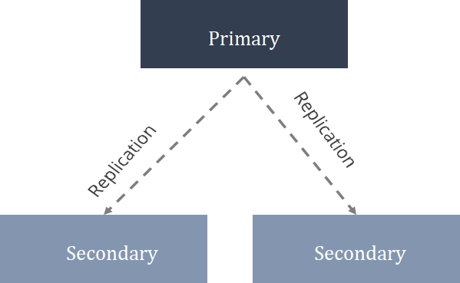
What Is Replication?
Creation of duplicate or clone of any object or entity.

Slide 8





Benefits of Replication are:
Why Replication?
No Downtime for Backup, Recovery, Indexing
High availability
Read Scalability
Disaster Recovery

Slide 9
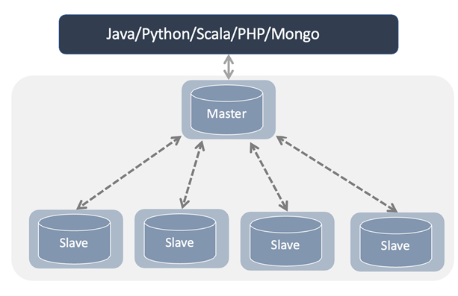
Master-slave Replication
Master-slave is the oldest mode of replication supported by MongoDB.
Features:
No automatic failover
Only one master and all others will be slave
Unlimited slave machines
Write operations happen only on master
Read operations can happen on master or slave

Slide 10
Replica Set Methodology In MongoDB
MongoDB Inc. recommends using Replica Set Methodology.
There are primary and secondary machines in Replica Set.
There can be only one primary machine; the rest will be secondary.
A Replica Set can have a maximum of 49 secondary machines.
A total of 50 machines can exist in a Replica Set.
Inc. recommends using Replica Set Methodology.

Slide 11
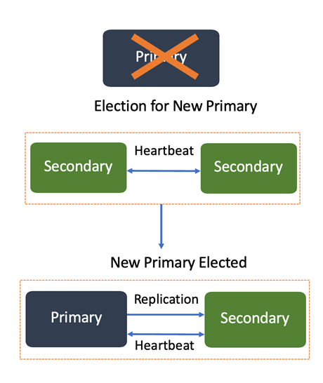
Automatic Failover
When the primary node of a replica set stops communicating with other members for more than 10 seconds, another member node is selected as the new primary.
The machine with the highest priority and votes that has the most updated data becomes the primary.

Slide 12
Hidden Replica Set Members
Hidden members of a replica set are invisible to the client applications.
Characteristics of hidden members:
They store a copy of the primary’s data.
They can elect a primary but cannot replace a primary.
They are not given appropriate read and write rights.
They can be used for dedicated functions like reporting and backup.
Secondary
Secondary
Primary
Secondary
priority: 0 hidden: true
Secondary

Slide 13
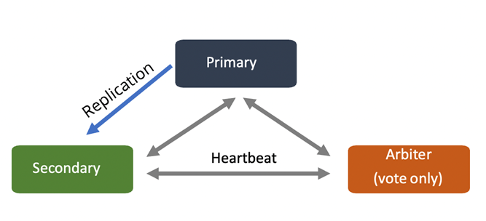
Arbiter Replica Set Members
Arbiters do not replicate or store data but play a crucial role in selecting a secondary to replace.
A typical replica set contains a primary, a secondary, and an arbiter.
Characteristics of Arbiters:
Arbiters do not maintain a dataset. Arbiters do not require a dedicated hardware.
An Arbiter is the node that just participates in an election to select the primary node.

Slide 14
Sharding

Slide 15

DISADVANTAGES OF REPLICATION
No write scalability as all writes go to master node.
Latency-sensitive queries still go to master.
Single replica set has limitation of 50 nodes.
Memory can't be large enough when active dataset is big.
Local Disk is not big enough.
Vertical scaling is too expensive.

Slide 16
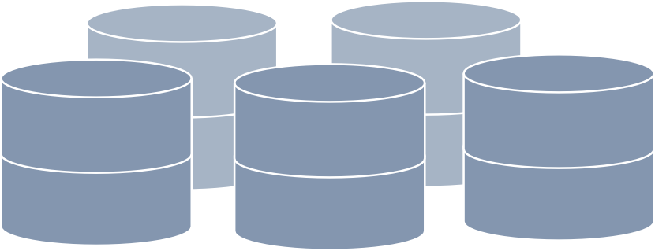
What Is Sharding ?
Sharding is a mechanism to distribute data horizontally.
It provides horizontal scalability.
It is good for heavy write and read operations.
Sharding is equivalent to partitioning in RDBMS.

Slide 17
When To Use Sharding?
There is a heavy write operation along with significant read operations.
The dataset outgrows the storage capacity of a single MongoDB instance.
The size of the active working set exceeds the capacity of the maximum available RAM.
A single MongoDB instance is unable to manage write operations.
Sharded clusters require a proper infrastructure setup, which increases the overall complexity of the deployment. Sharded clusters should be deployed only when:

Slide 18

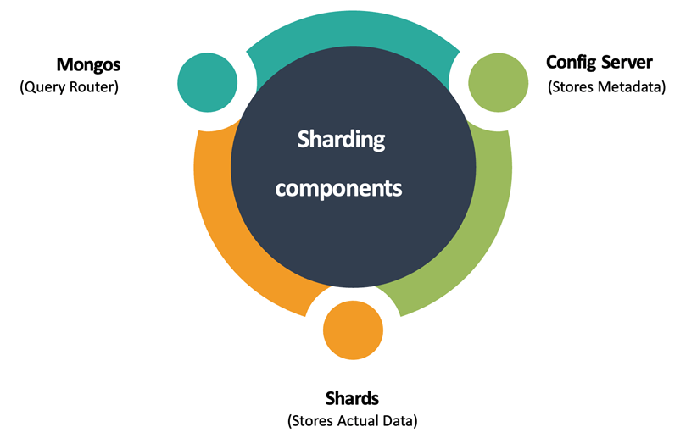
SHARDED CLUSTER COMPONENTS

Slide 19

Thank you!

